Slide 1
Introduction to Python for data analysis

Slide 2
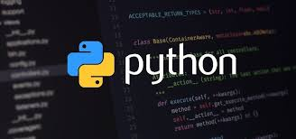
What is Python?
Python is a versatile and user-friendly programming language that is widely used for data analysis, web development, automation, and machine learning. Its simplicity and readability make it ideal for beginners, while its extensive libraries and frameworks cater to advanced applications.

Slide 3
Why use Python for data analysis?
1. Ease of Learning: Python has a simple syntax that is easy for beginners to learn.
2. Comprehensive Libraries: Python offers specialized libraries for data manipulation, analysis, and visualization, such as:
NumPy: For numerical computations.
Pandas: For data manipulation and analysis.
Matplotlib and Seaborn: For data visualization.
Scikit-learn: For machine learning and predictive modeling.
3.Community Support: A large and active community provides resources, tutorials, and troubleshooting.

Slide 4
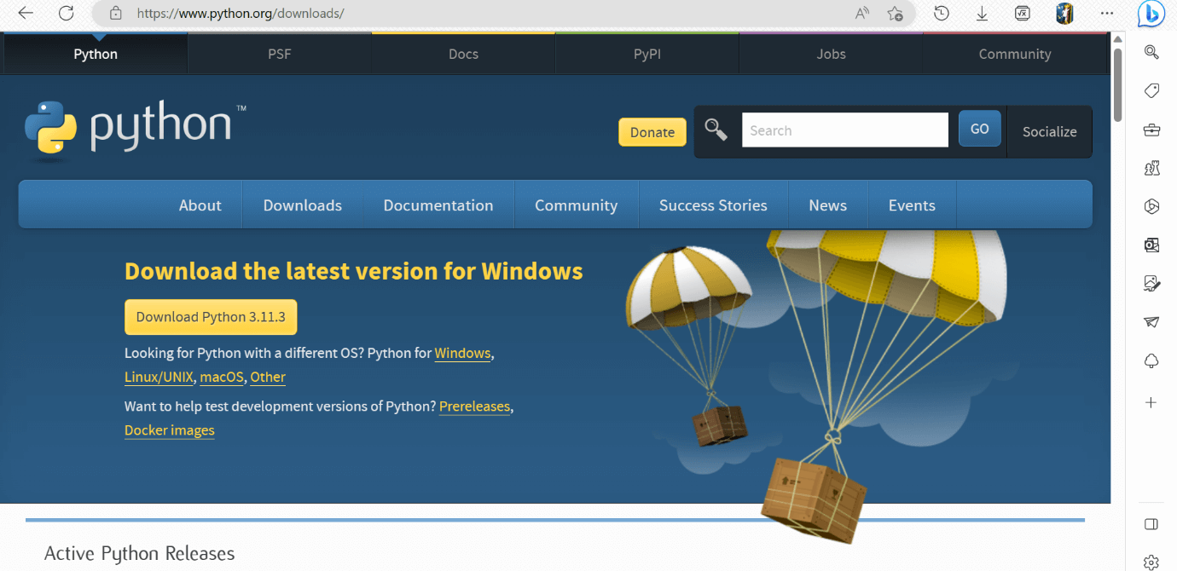
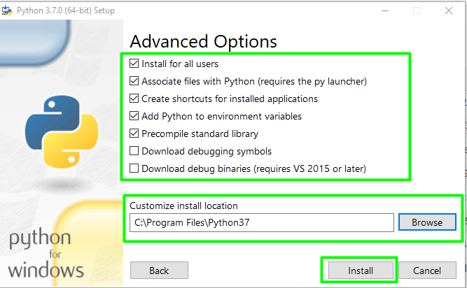
Getting started
1. Installing Python
Use a distribution like Anaconda which bundles Python and essential libraries for data analysis. Alternatively, install Python via its official website and use pip to manage libraries.

Slide 5
2. Basic workflow
Import libraries: Essential libraries like NumPy, Pandas, and Matplotlib.
Load Data: Use Pandas to load datasets from CSV, Excel, databases, or other sources.
Preprocess Data: Clean and transform data (handle missing values, normalize, etc.).
Analyze Data: Perform calculations, group data, and extract insights.
Visualize Data: Use visualization libraries to create charts and graphs.

Slide 6

Core libraries overview
1. NumPy
Efficient handling of numerical data.
Provides support for arrays and matrix operations.
Example:
import numpy as np
array = np.array([1, 2, 3, 4])
print(array.mean()) # Output: 2.5

Slide 7

2. Pandas
Ideal for handling tabular data.
Offers data structures like DataFrames and Series.
Example:
import pandas as pd
data = {'Name': ['Alice', 'Bob'], 'Age': [24, 27]}
df = pd.DataFrame(data)
print(df)

Slide 8
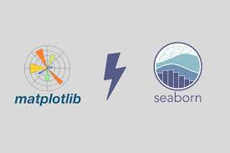
3. Matplotlib & seaborn
Used for creating static, animated, and interactive visualizations
Example:
import matplotlib.pyplot as plt
x = [1, 2, 3, 4]
y = [10, 20, 25, 30]
plt.plot(x, y)
plt.show()

Slide 9
Typical data analysis workflow
1. Understand the Problem: Define the question you want to answer with data
2. Load Data: Use Pandas or other libraries to load the dataset
df = pd.read_csv('data.csv’)
3. Clean Data: Handle missing values, remove duplicates, and standardize data
df.dropna(inplace=True) # Remove rows with missing values

Slide 10
4. Explore Data: Generate summary statistics and visualize the data
print(df.describe())
df['column_name'].hist()
5. Analyze Data: Use statistical or computational methods to find insights
6. Communicate Results: Use visualizations and reports to present findings.

Slide 11
Conclusion
Python is a powerful, flexible, and beginner-friendly language that has become a cornerstone in the field of data analysis. Its simplicity, combined with a rich ecosystem of libraries like NumPy, Pandas, Matplotlib, and Seaborn, allows users to efficiently manipulate, analyze, and visualize data.

Slide 12

Thank you
ajaycraju98@gmail.com

